Slide 1
CSCI3170 Introduction to Database Systems
Tutorial 5 – Connect to MySQL Database, Run MySQL in Java

Slide 2
Items to Learn
CSE VPN
Connect to Linux Servers
Connect to your MySQL Database
In Terminal
In Java
Run MySQL Statement in Java

Slide 3
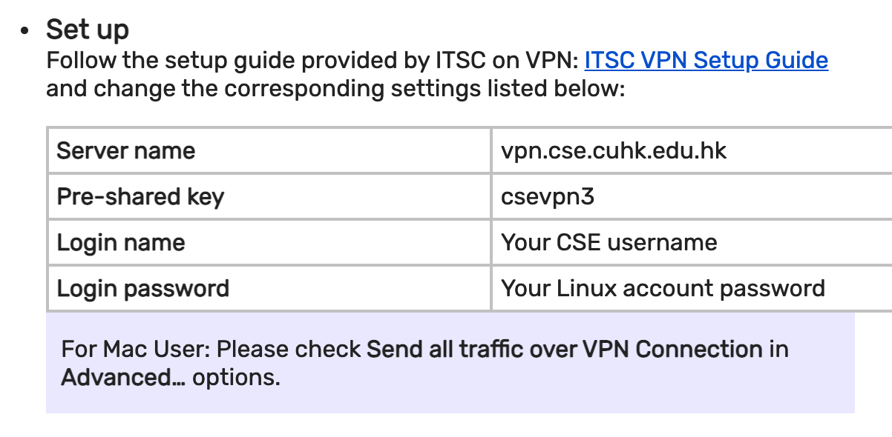
1. CSE VPN
IPSec: Similar to CUHK VPN, except

Slide 4
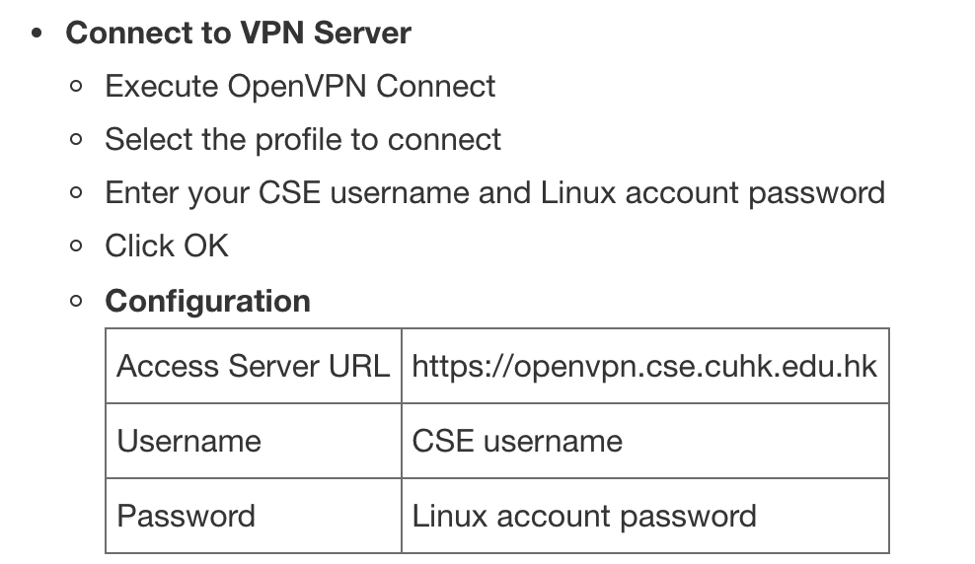
1. CSE VPN
OpenVPN:

Slide 5
2. Connect to Linux Servers
Host Name: linux1.cse.cuhk.edu.hk
Port: 22
For Linux/MacOS, just type in the terminal:
For other system, may need some tools.
ssh username@linux1.cse.cuhk.edu.hk
Putty
SSH Secure Shell(Recommended)

Slide 6
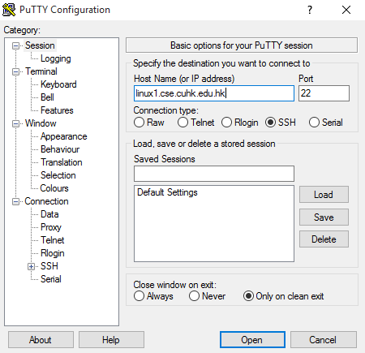
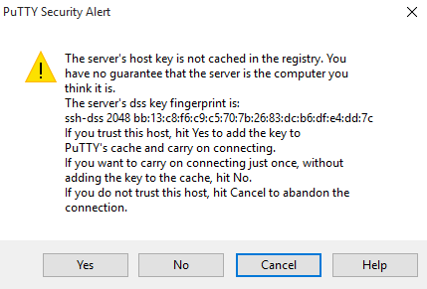
Connect to Linux Servers via Putty (1)
Click “Yes” if this window appears

Slide 7
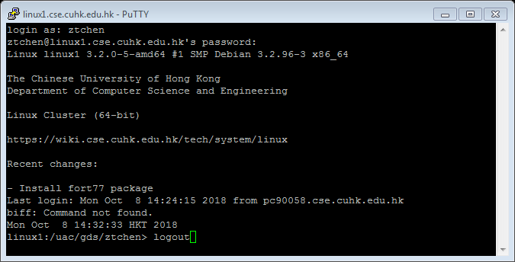
Connect to Linux Servers via Putty (2)
Type the “username” and “password” of your CSE Linux/Windows Account. Then press “enter”
For the sake of security, our CSE Linux server will not show **** while you are typing a password.
Type logout or exit to quit.

Slide 8
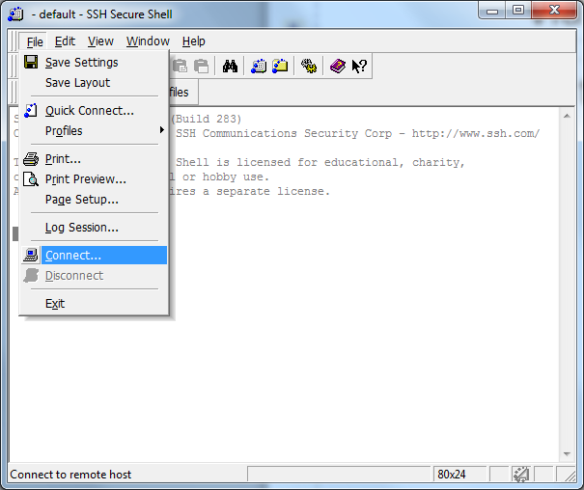
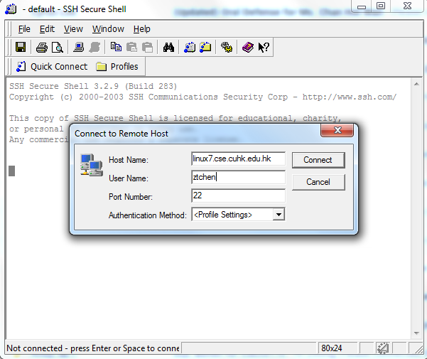
Connect to Linux Servers via SSH Secure Shell (1)

Slide 9
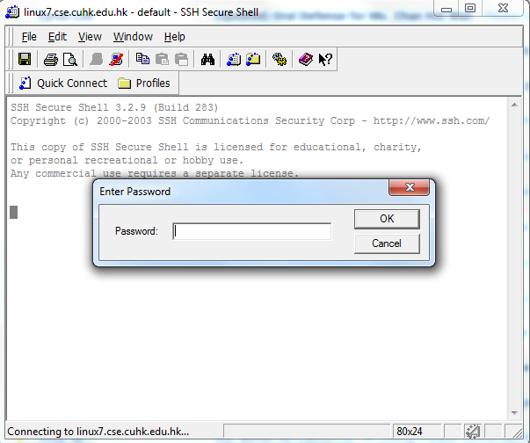
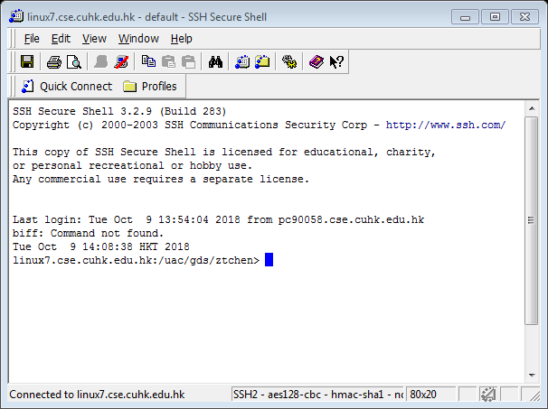
Connect to Linux Servers via SSH Secure Shell (2)

Slide 10
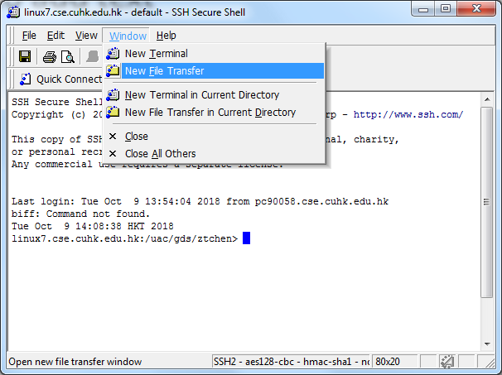
Why SSH Secure Shell Recommended

Slide 11
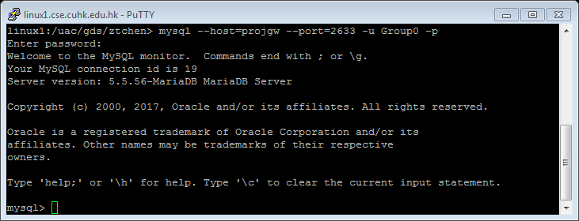
3. Connect to MySQL(In Terminal)
After you login successfully, type:
to access MySQL using your MySQL account.
mysql --host=projgw --port=2633 -u username –p
username is your group name,
e.g. Group11
default password: CSCI3170

Slide 12
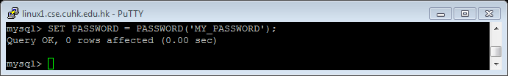
Change Password
Change password of logged in user
Please make sure your groupmates know the password
SET PASSWORD = PASSWORD(‘YOUR_PASSWORD’);

Slide 13

Use your database
Switch to the database
USE <your_database>;
database e.g. db11
db11 is for Group11

Slide 14
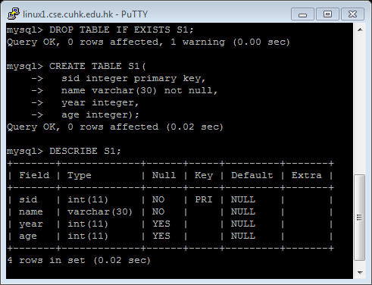
Run MySQL Statements
(Pre-cautionary) dropping the table
Create Table
Show the table schema
DROP TABLE IF EXISTS S1;
CREATE TABLE S1(
sid integer primary key,
name varchar(30) not null,
year integer,
age integer);
DESCRIBE S1;

Slide 15
3. Connect to MySQL(In Java)
Download “mysql-connector-java-version.jar” from Blackboard
Transfer the JAR file to the server by using scp command or FTP software like WinSCP
When running your java code, include the path of “mysql-connector-java-version.jar”
java –cp .:path_to_connector class_name

Slide 16
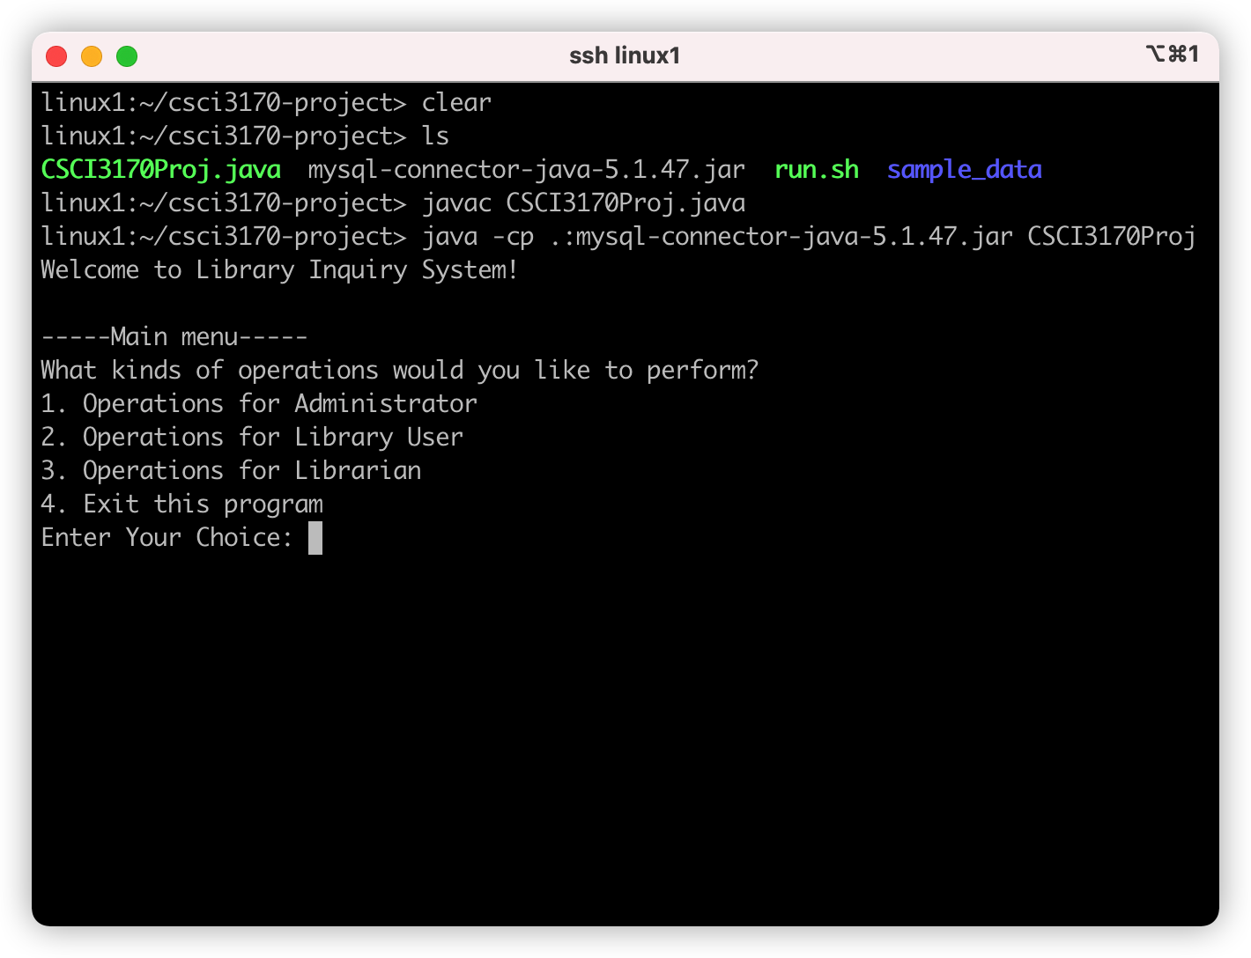
3. Connect to MySQL(In Java)

Slide 17
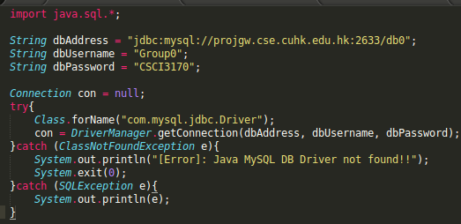
3. Connect to MySQL(In Java)
More Detail can be found in Connecting to MySQL Using the JDBC DriverManager Interface.

Slide 18
4. Run MySQL Statement in Java
Method 1:(Statement)
String sql = ***;
Connection con= ***;
Statement stmt = con.createStatement();
For sql involved create, insert, update, drop, delete:
stmt.executeUpdate(sql);
For select query:
ResultSet rs = stmt.executeQuery(sql);
More details can be found in Using JDBC Statement Objects to Execute SQL

Slide 19
For statement with Parameters
If you write gender = %s here,
then your sql statement may be:
SELECT * FROM student
WHERE age = 20 and gender = male;
Notice that male is regarded as a column name instead of a string value.
String sql = "SELECT * FROM student WHERE age = %s and gender = ‘%s’;"
String aUserInputAge = ***;
String aUserInputGender = ***;
sql = String.format(sql, aUserInputAge, aUserInputGender);
Connection con= ***;
Statement stmt = con.createStatement(sql);
ResultSet resultSet = stmt.executeQuery();

Slide 20
4. Run MySQL Statement in Java
Method 2:(PreparedStatement)
String psql = "SELECT * FROM student WHERE age = ? and gender = ? ;"
String aUserInputAge = ***;
String aUserInputGender = ***;
Connection conn= ***;
PreparedStatement pstmt = conn.prepareStatement(psql);
pstmt.setInt(1, Integer.parseInt(aUserInputAge));
pstmt.setString(2, aUserInputGender);
ResultSet resultSet = pstmt.executeQuery();
More details can be found in PreparedStatement interface

Slide 21
Output records in ResultSet
String sql = “SELECT name, age FROM student; ”
…….
ResultSet resultSet = stmt.executeQuery(sql);
if(!resultSet.isBeforeFirst())
System.out.println("No records found.");
else
while(resultSet.next()){
System.out.print(resultSet.getString(1));
System.out.print(resultSet.getInt(“age”));
}
More details can be found in JDBC: ResultSet.
Either column index or column name is OK.

